Slide 1
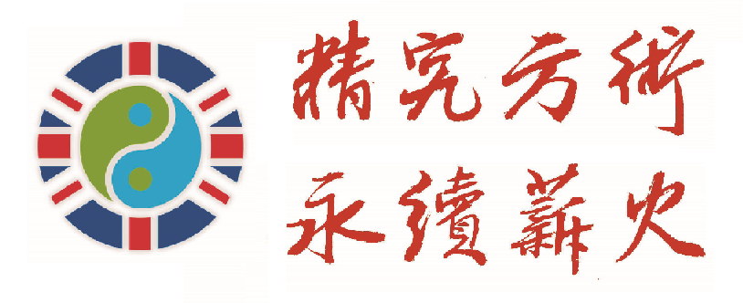
英国新冠病毒感染中医治疗报告 TCM Treatment for Covid-19 in the UK
陈赞育 Zanyu Chen
英国中医师学会FTCMP
Federation of Traditional Chinese Medicine Practitioners in the UK

Slide 3
英国中医在行动 UK TCM in Action
1，FTCMP自2月21日以来，随着疫情的变化，在学会会员群每周学术讲座的基础上，我们开始了针对会员的每日一讲“英国中医师学会新冠肺炎专题讲座”；
From 21st Feb., FTCMP started presenting 10 academic talks focused on COVID-19 to all of our members in order to prepare for the coming challenge.
2，FTCMP学术期刊《英国中医》开辟了“新冠肺炎专题”栏目，发布了多位专家的新冠研究成果；
A special edition of the Journal of Chinese Medicine in the UK is to be published, focusing on the topic of COVID-19.
3，FTCMP与英国凤凰医药集团合作，共同向社会捐赠了近万英镑的防疫抗疫中药；
FTCMP and Phoenix Medical Group united made around 10,000 pounds worth of herbal medicine for the UK society in order to balance the body and boost immunity. About 500 people have been benefited directly.

Slide 4
FTCMP年会，学术盛宴
2020年FTCMP学术年会在广州中医药大学信息技术学院岐黄网的支持下，从伦敦转到网上。十五位主讲人汇集了国内外享有盛誉的中医专家紧扣专题，深刻实用，学则能用，用则济世。
周永学教授、黄煌教授、王飞教授、沈其霖教授、赵亮副教授带来国内研究前沿成果，高屋建瓴，真才卓识；
于福年教授、唐铁军博士带来欧洲大陆中医一线和英国兄弟学会的精彩学术分享，他山之石，可以攻玉；
英国中医师学会王友军顾问、汤淑兰顾问、陈赞育会长、袁炳胜常务副会长、殷鸿春部长、周继成部长、周华芝部长、杨波部长尽展所学，共克时艰。
2020 FTCMP annual academic conference recently concluded online, with support from qihuanghealthcare.com. 15 well respected TCM professionals gave keynote speeches on the topic of COVID-19 during the 15 days of the online event, and the speeches have received over 80,000 views online.

Slide 5
认识新冠病毒 What is Coronavirus In TCM
寒湿燥杂合成毒，发为疫疠
The common symptoms of COVID-19 reflect the pathogen’s properties of cold and dampness with long-lasting Yin impairment.
英国四面环海，冬季湿冷而且多风，今年冬季尤其湿重，是近几年来雨水较多的一年，日照严重不足
The damp element is dominating in the UK environment.

Slide 6
防治新冠病毒 Treat Coronavirus by TCM
正气存内，邪不可干
Strengthening the Qi and balancing the body are universal prevention for all possible attackers.
祛湿散寒存阴，特异性防疫
Expelling cold, eliminating dampness and supporting Yin are profound principles for treating COVID-19.

Slide 7
防治新冠病毒 Treat Coronavirus by TCM
化湿、散湿、祛湿、利湿
Resolving, Expelling, Eliminating and Draining the dampness.
藿香，紫苏叶，白豆蔻，苍术，芦根，茯苓，荷叶，茯苓等等

Slide 8
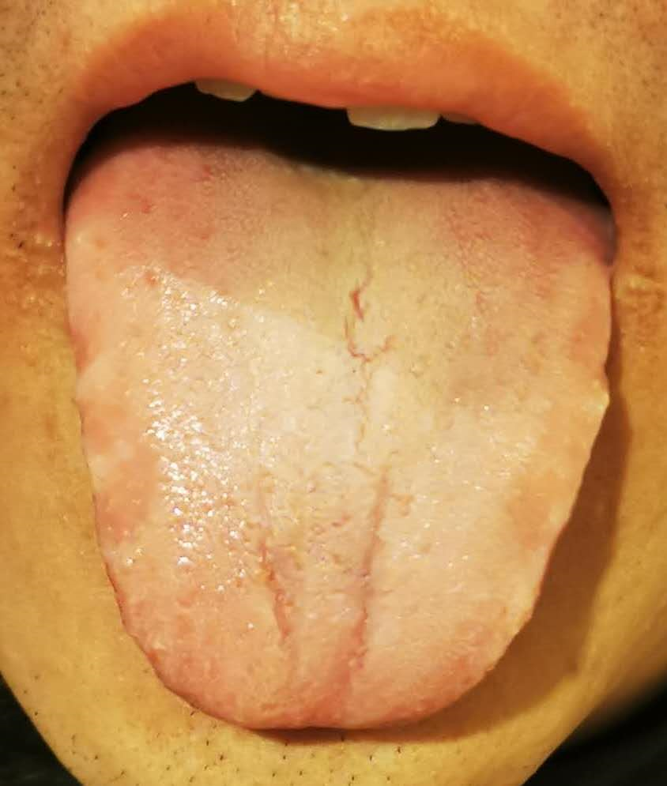
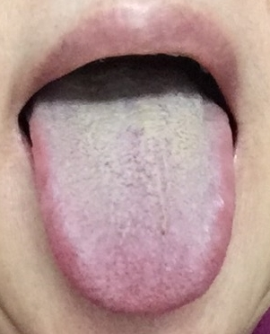
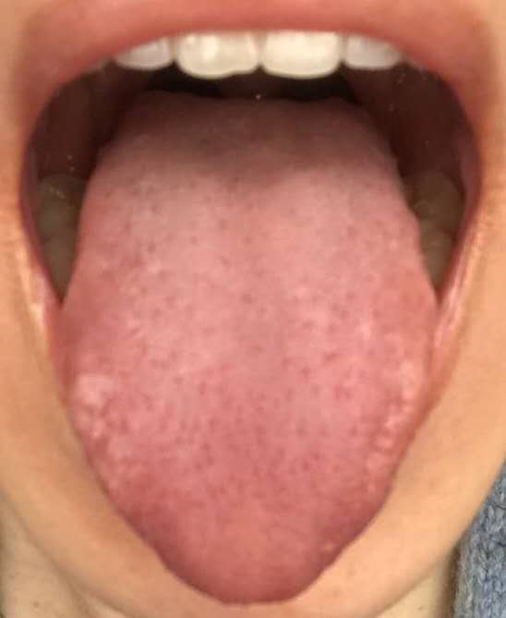
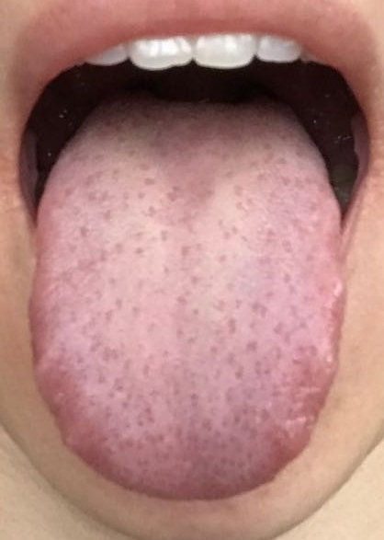
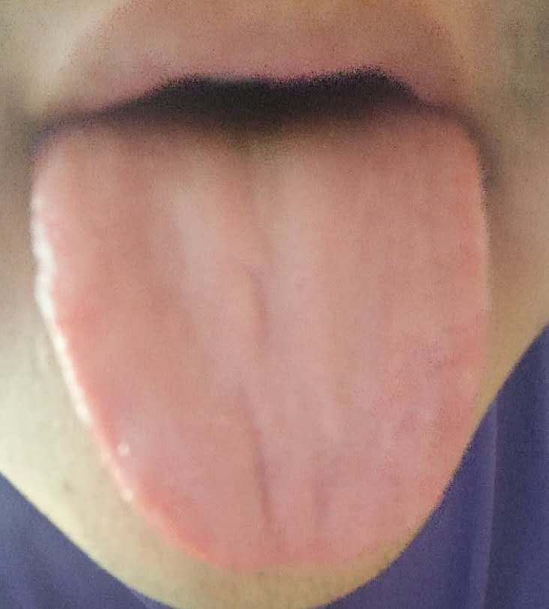
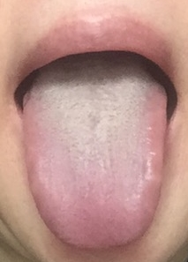
典型病例报告 Case Report

Slide 9
Thank You

